Slide 1
Virtual Desktop infrastructure
BALLARI INSTITUTE OF TECHNOLOGY AND MANAGEMENT
Presented By:
R M Harshitha -3BR23CS123
M Chandana -3BR23CS086
Preethi K -3BR23CS120
Raziya M -3BR23CS127
Parimala C -3BR23CS116
Trainer Signature:

Slide 2
synopsis
What is VDI?
What are the components of VDI?
Learning from past Misconfigurations
Optimizing VDI for success
Benefits of VDI
Conclusion

Slide 3
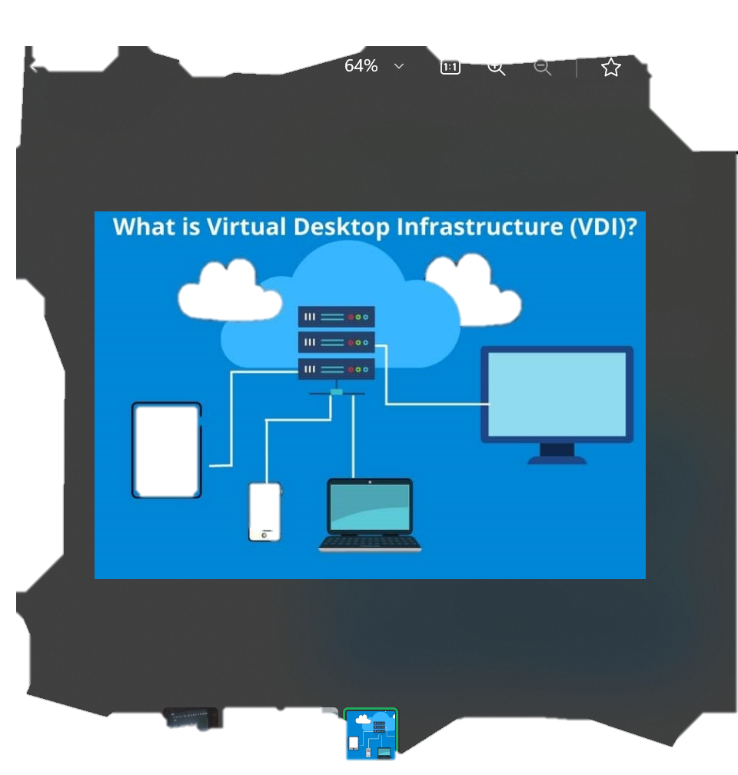
what is VDI?
VDI(virtual desktop infrastructure) is a technology used to create a virtualized desktop environment on a remote server setup.

Slide 4
In simpler terms by using VDI you can access your virtual desktops remotely
What are the basic components of VDI?
Traditional Architecture
Applications
Operating system
hardware
1 virtualization
Virtualization
It is the creation of a virtual version of a desktop ,OS ,server or storage.
2 hypervisor
3 connection Broker
4
Desktop pools
5
Application virtualization
Virtual Architecture
App App
OS OS
Virtualization layer
hardware

Slide 5
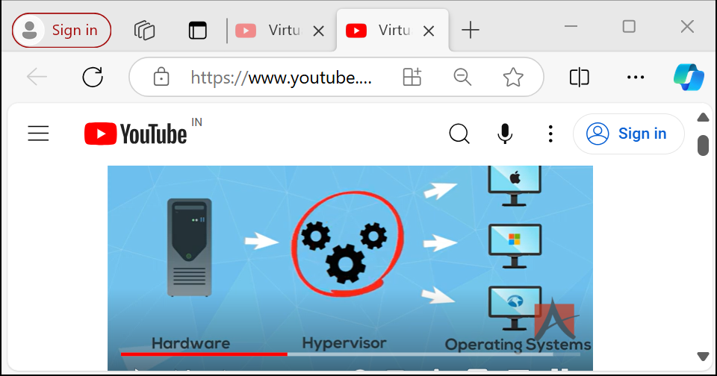
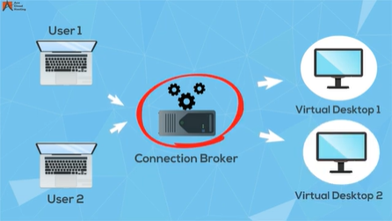
Hypervisor connection broker
It is a software program that allows the end-user to connect to a virtual desktop
Hypervisor is a software that seperates the operating system from the underlying hardware by creating a virtualized environment

Slide 6
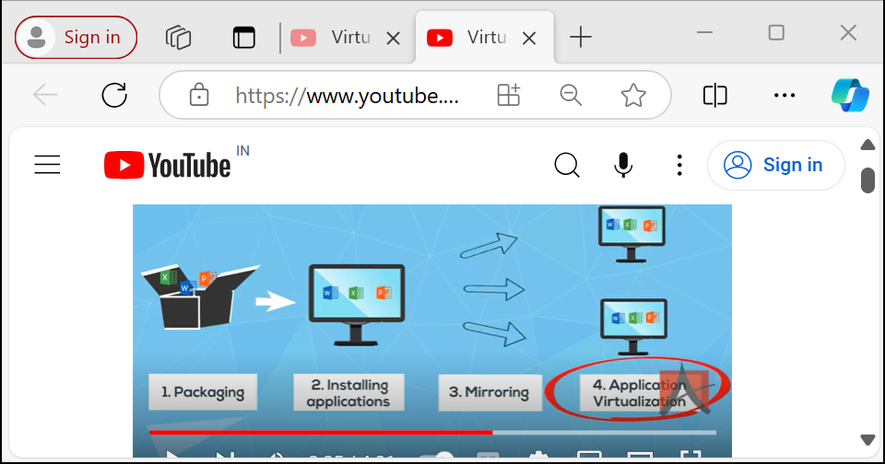
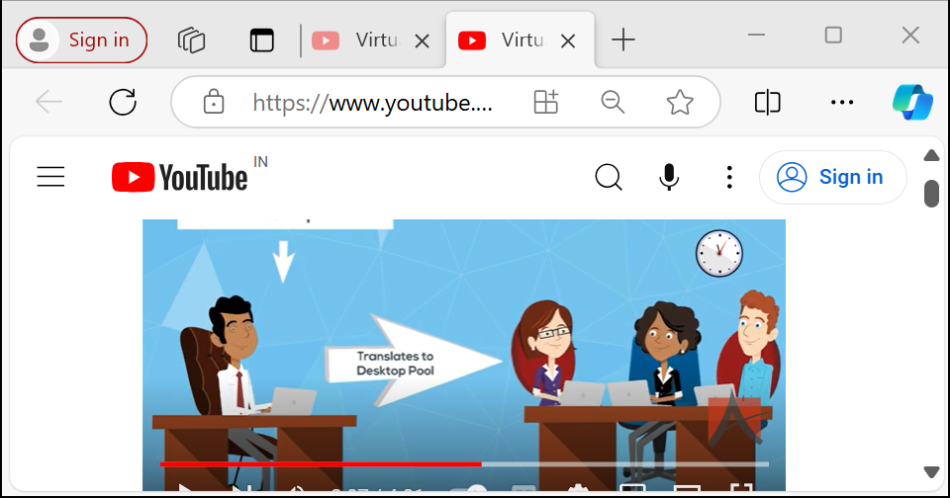
Desktop pools Application virtualization
A Desktop pool is a group of virtual desktops with an identical configuration such as OS,storage,and applications.
Application virtualization is the technology used to create a virtualized application image and replicate it to all the virtual desktops in a desktop pool.

Slide 7
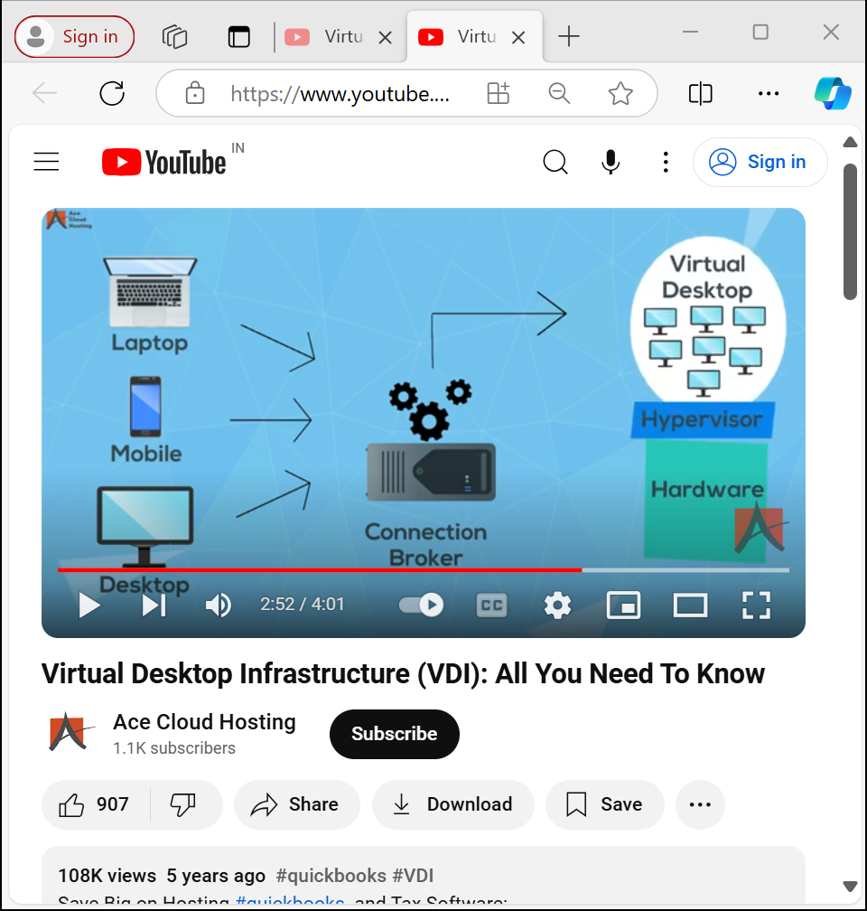
How vdi works?
User sends login request to their end point device
Connection broker accepts the request.
Now the user can use desktop according to their process.

Slide 8
Learning from Past Misconfigurations
Insufficient Resources :
Highlight the adequate hardware resources to avoid performance issues and enhance user satisfaction.
Network Challenges :
Network misconfiguration on VDI performance.
Graphic Acceleration:
Proper graphics acceleration in running graphics intensive application within a VDI environment.
User Profile Management:
Effective user profile management for personalization and a consistent user experience.

Slide 9
Optimizing VDI For Success
Resource Allocation Best Practices:
Provides actionable tips on optimizing CPU , RAM , and storage allocation for an efficient VDI environment.
User profile Management Tools:
Recommend efficient user profile management tools to facilitate personalization and consistency across virtual desktop sessions.
Security best practices:
Highlight recommended security measures for VDI configurations balancing protection and performance effectively

Slide 10
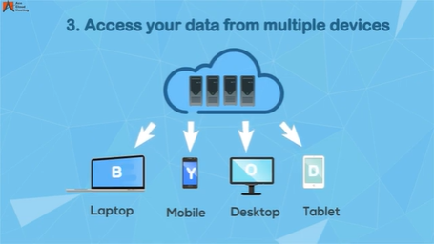
Benefits of virtual desktop infrastructure (Vdi)
To have inclined growth ,companies have started using advanced methodologies in their businesses.
They have been continuously trying new technologies to reduce all the work-related challenges faced by the workforce.
Access your data from anywhere and anytime.
Instant backup of the data.
Access your data from multiple devices.

Slide 11
Conclusion By addressing past challenges and optimizing VDI configurations , organizations can unlock the full potential of virtual desktop infrastructure , fostering a positive and efficient user experience in the modern digital workspace.

Slide 12
thank you

Slide 13
algorithm
Step 1: Initialize Virtual Desktop ManagerCreate an empty dictionary desktops to store virtual desktops.Initialize an empty VirtualDesktopManager object.
Step 2: Display MenuDisplay the main menu with options:Create DesktopRead DesktopUpdate DesktopDelete DesktopMonitor PerformanceExit
Step 3: Handle User InputGet user input (option number).Perform corresponding action based on user input:
Option 1: Create DesktopPrompt user for:Desktop IDDesktop nameOperating systemRAM allocationCPU allocationCreate a new VirtualDesktop object with user input.Add the VirtualDesktop object to the desktops dictionary.
Option 2: Read DesktopPrompt user for Desktop ID.Retrieve the corresponding VirtualDesktop object from the desktops dictionary.Display desktop details.
Option 3: Update DesktopPrompt user for Desktop ID.Retrieve the corresponding VirtualDesktop object from the desktops dictionary.Prompt user for updated values (optional):Desktop nameOperating systemRAM allocationCPU allocationUpdate the VirtualDesktop object with new values.
Option 4: Delete DesktopPrompt user for Desktop ID.Remove the corresponding VirtualDesktop object from the desktops dictionary.
Option 5: Monitor PerformancePrompt user for Desktop ID.Retrieve the corresponding VirtualDesktop object from the desktops dictionary.Prompt user for performance metrics:CPU usageRAM usageDisplay performance metrics.
Option 6: ExitTerminate the program.
Step 4: Repeat Menu DisplayRepeat Step 2 until user chooses to exit.

Slide 14
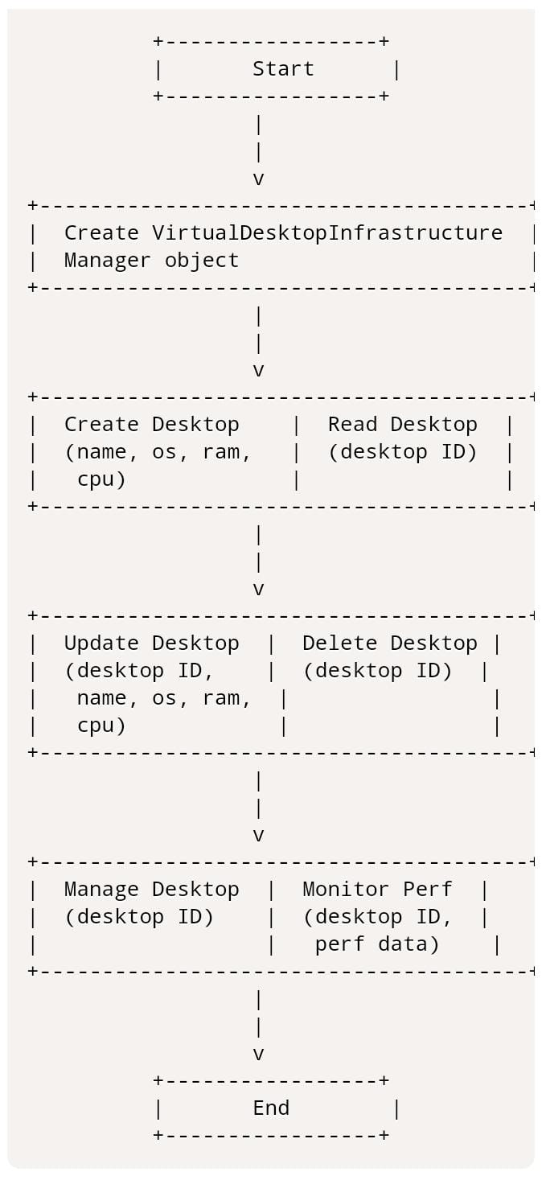
F
L
O
W
C
H
A
R
T

Slide 15
CODE
def remove_vm(self, name):
if name in self.vms:
del self.vms[name]
print(f"VM '{name}' removed successfully.")
else:
print(f"VM '{name}' not found.")
def list_vms(self):
print("Virtual Machines:")
for vm in self.vms.values():
print(f"{vm.name} - {vm.os} - {vm.status}")
def manage_vm(self, name):
if name in self.vms:
vm = self.vms[name]
print(f"Managing VM '{name}':")
print("1. Start")
print("2. Stop")
print("3. Restart")
choice = input("Enter choice: ")
if choice == "1":
vm.start()
elif choice == "2":
vm.stop()
elif choice == "3":
vm.restart()
else:
print("Invalid choice.")
else:
print(f"VM '{name}' not found.")
class VirtualMachine:
def __init__(self, name, os, ram, cpu, storage):
self.name=name
self.os=os
self.ram = ram
self.cpu = cpu
self.storage = storage
self.status = "Offline"
def start(self):
self.status = "Running"
print(f“{self.name} started successfully”)
def stop(self):
self.status = "Offline"
print(f"{self.name} stopped successfully.")
def restart(self):
self.stop()
self.start()
class VDIManager:
def __init__(self):
self.vms = {}
def add_vm(self, vm):
self.vms[vm.name] = vm
print(f"VM '{vm.name}' added successfully.")

Slide 16
def main():
vdi_manager = VDIManager()
while True:
print("VDI Manager")
print("1. Add VM")
print("2. Remove VM")
print("3. List VMs")
print("4. Manage VM")
print("5. Exit")
choice = input("Enter choice: ")
if choice == "1":
name = input("Enter VM name: ")
os = input("Enter OS: ")
ram = input("Enter RAM: ")
cpu = input("Enter CPU: ")
storage = input("Enter storage: ")
vm = VirtualMachine(name, os, ram, cpu, storage)
vdi_manager.add_vm(vm)
elif choice == "2":
name = input("Enter VM name: ")
vdi_manager.remove_vm(name)
elif choice == "3":
vdi_manager.list_vms()
elif choice == "4":
name = input("Enter VM name: ")
vdi_manager.manage_vm(name)
elif choice == "5":
break
else:
print("Invalid choice.")
if __name__ == "__main__":
main()

